Slide 1

Predicting Diabetes With Artificial Intelligence
Isabella Taylor
Leah Nash
Sandra Braun
Valerie Grannemann-Barber

Slide 2

Background
Diabetes is a chronic disease that affects how your body utilizes insulin to transport circulating blood glucose into cells for energy consumption
Three main types of diabetes¹
More than 133 million people in the United States have diabetes or prediabetes¹
Medical costs and lost work and wages related to diabetes total $327 billion yearly¹
¹CDC Diabetes Information Page
Notes:
Type 1, Type 2, Gestational Diabetes (diabetes while pregnant)
37 million US adults have diabetes1
1 in 5 of people in the United States do not know they have diabetes
96 million US adults—over a third—have prediabetes1
8 in 10 of people in the United States do not know they have prediabetes
People with diabetes medical costs are twice as high as for people who don’t have diabetes

Slide 3
Dataset
Behavioral Risk Factor Surveillance System (BRFSS)
US-based annual telephone survey
Kaggle
Link: Diabetes Health Indicators Dataset
3
Predicting diabetes with ai

Slide 4

Method
PySpark was utilized to read in the raw data and utilize SQL queries for EDA
Descriptive statistics were performed to understand the population included in the dataset
Tableau for visualizations:
Diabetic Status Comparison
4

Slide 5
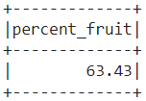
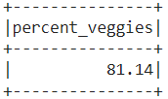
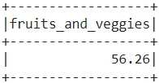
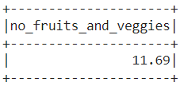
SQL queries
Percentage of people who eat 1+ fruits per day
Percentage of people who eat 1+ vegetables per day
Percentage of people who eat 1+ fruits and vegetables per day
Percentage of people who don’t eat fruits or vegetables
5

Slide 6
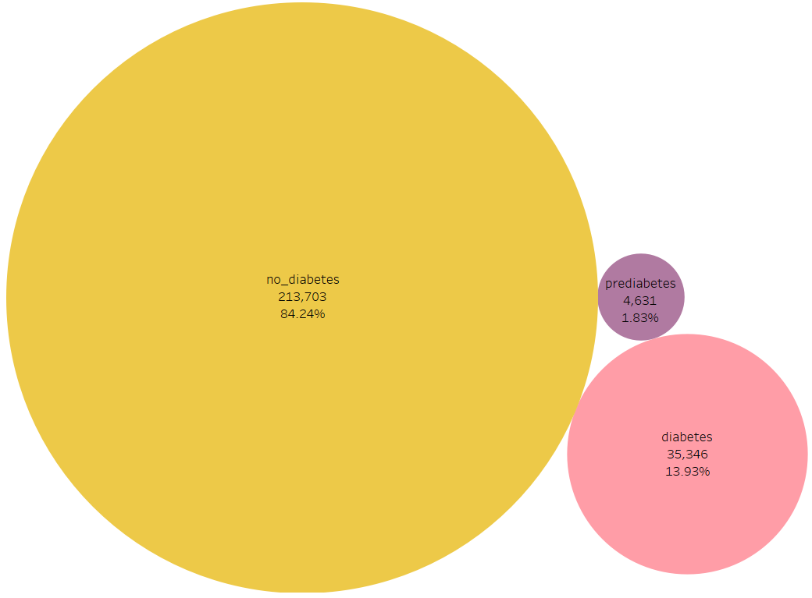
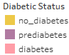
visualizations
Total Distribution of Diabetic Status
Count of people and the percentage of having no diabetes, prediabetes, or diabetes.
Everyone in the study is over the age of 18.
Those that have gestational diabetes while pregnant are counted as having no diabetes.

Slide 7
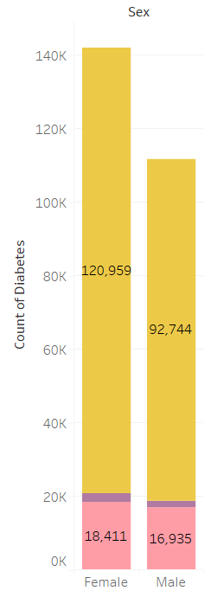
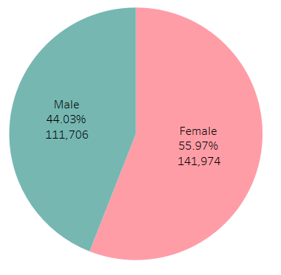
visualizations
Diabetic Status Comparison by Sex
Comparison of Male and Female participants within the population of the study.
Count of no diabetes, prediabetes, and diabetes in Male and Female participants.

Slide 8
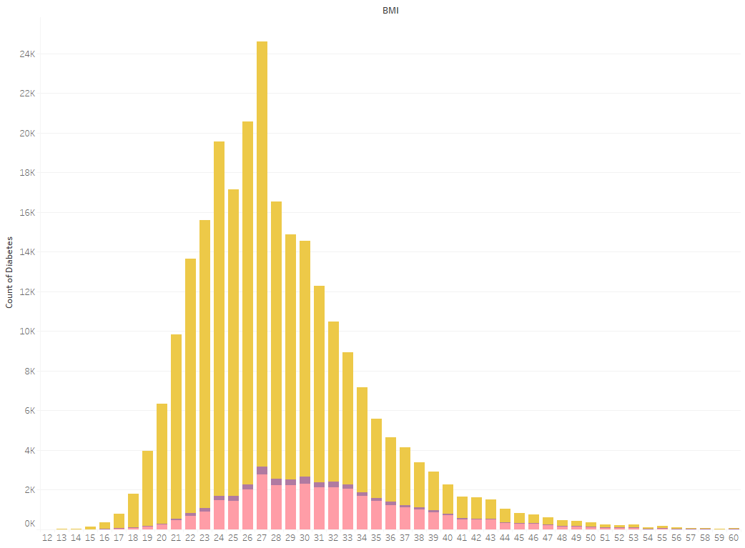
visualizations
Distribution of Diabetic Status by BMI
As the BMI gets larger, the number of non-diabetics and diabetics become closer.
Indicating that the higher the BMI, the higher the chance of having diabetes.

Slide 9
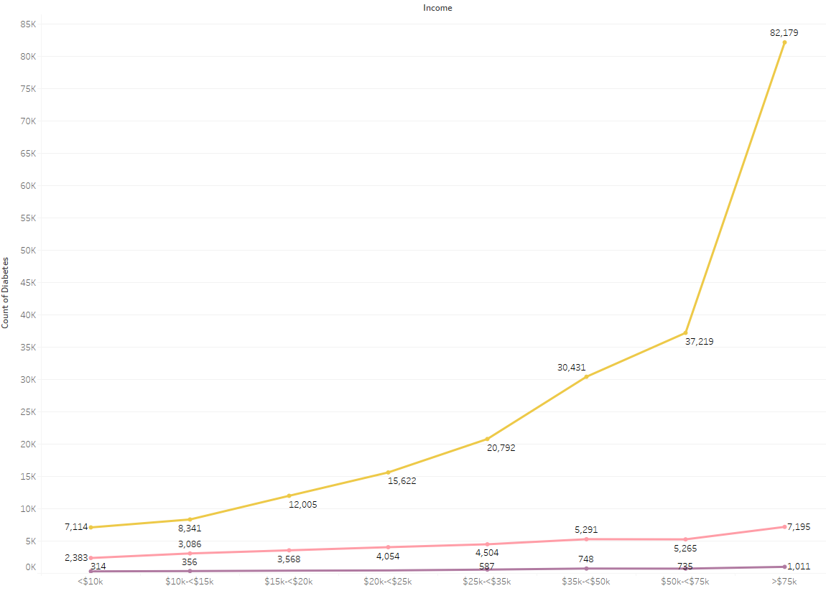
visualizations
Diabetic Status by Income Category
The amount of people that do not have diabetes significantly rise the higher the income.
Whereas the number of people with prediabetes and diabetes stays more consistent through each income category.

Slide 10
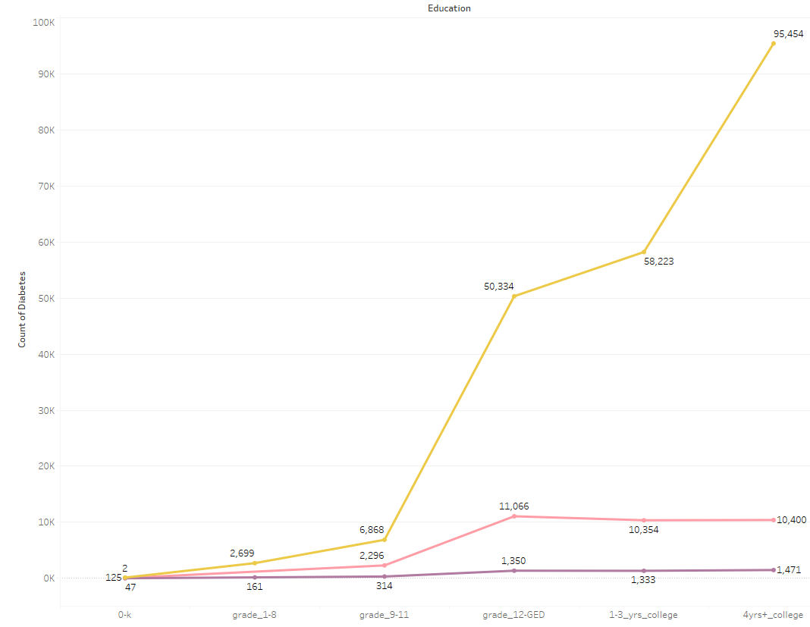
visualizations
Diabetic Status by Education Category
There is a significant jump in those that do not have diabetes once they have completed a high school education.
The number of people with prediabetes and diabetes stays more consistent through each income category, having a small jump after having a high school education.
The trend of education and income are similar.

Slide 11
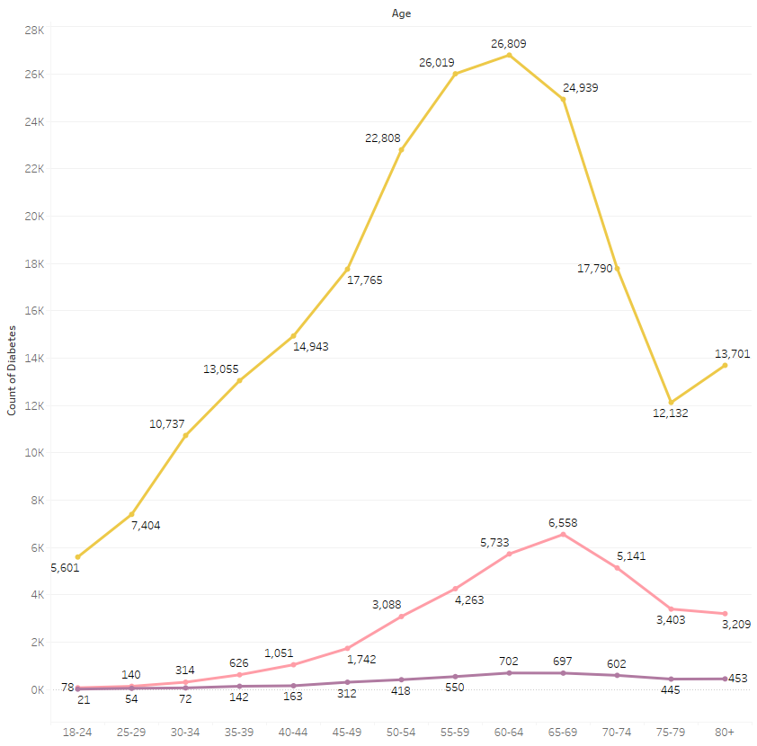
visualizations
Diabetic Status by Age Category
There is a rise in those that have diabetes after the age of 50.
This could be due to a multitude of different factors. Such as aging, and other comorbidities.

Slide 12
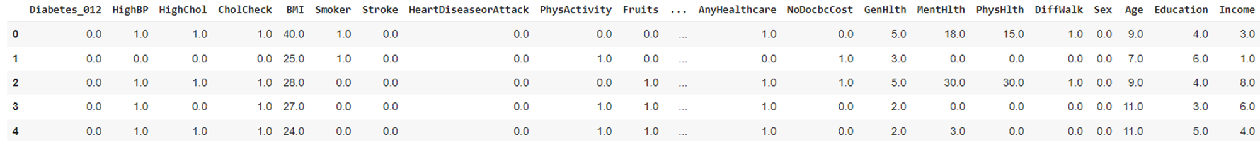
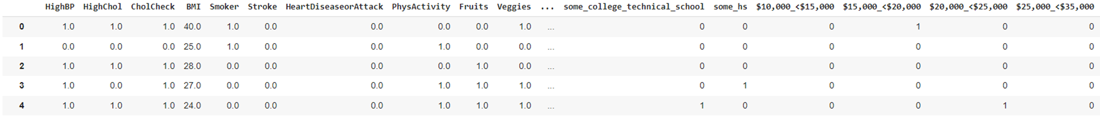
Data Cleaning
All categorical columns were encoded
Diabetes_012, Age, Education, Income
Before:
After:
12

Slide 13
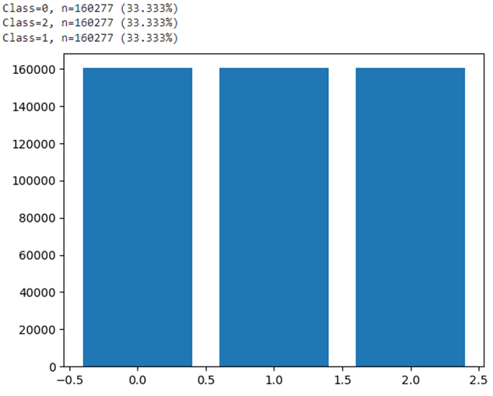
Models & Results
Over Sampling with SMOTE
Used synthetic minority over-sampling technique (SMOTE) to address class imbalance in the pre-diabetes and diabetes status population.
Results:
13

Slide 14
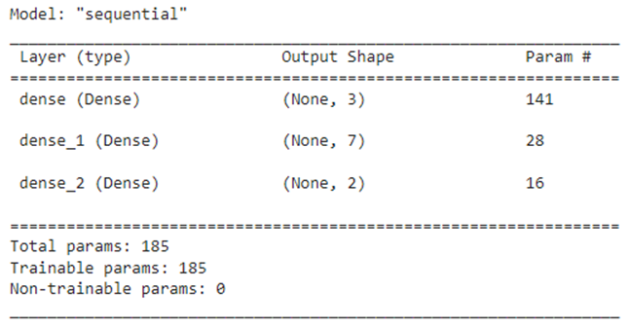
Models & Results
Automated Neural Network without Pre-Diabetes
Pre-diabetes was removed from the target and added to the features
An auto neural network model was run with the new parameters
Best model collected from auto neural network model
Best Model:
Loss & Accuracy from Auto NN Test:
14
Notes:
created an automated neural network to test the best hyperparameter options

Slide 15
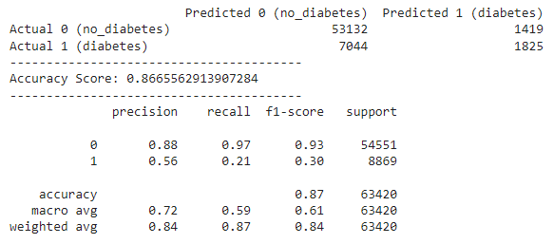
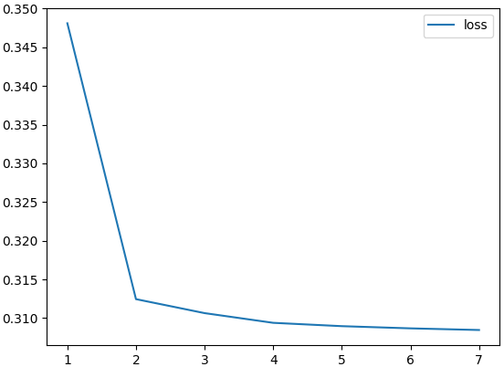
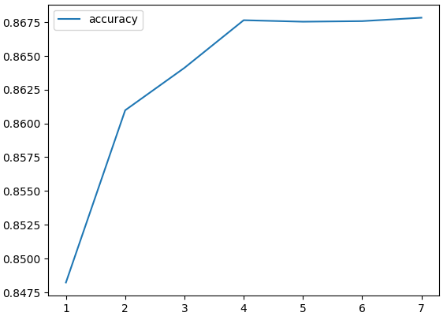
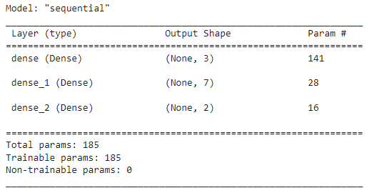
Models & Results
Results:
Neural Network using Best Model
Accuracy aligned with the results we were expecting
Most accurate model
Best Model Used:
Notes:
created a model using the best model from the auto NN
better accuracy and loss

Slide 16
Models Removed
Original dataset:
Random Forest
Decision Tree
Logistic Regression
Neural Network with Random Oversampler
Cleaned dataset:
Neural Network Model with Oversampled Data
Logistic Regression with Oversampled Data
Logistic Regression with Random Oversampler
Logistic Regression with multioutput Classifier & SMOTE
Automated Neural Network with Oversampled data
16

Slide 17
Discussion limitations & future work
Challenges
Imbalanced data
Self reported data
Feature Engineering
17

Slide 18
Summary
While we were able to achieve a satisfactory overall accuracy score on our final model, the predicting power for diabetes and no diabetes would likely not be acceptable to be used in a clinical setting.
Despite our inability to predict for prediabetes, it was a valuable learning experience that taught us the importance of trial and error when developing a data model for practical applications.

Slide 19

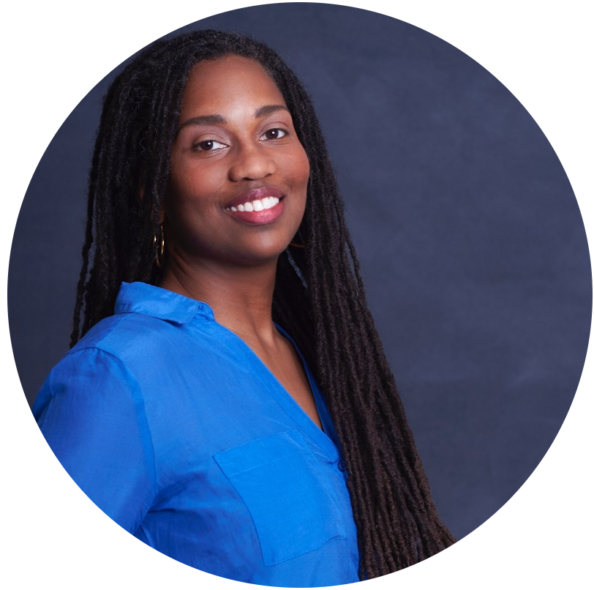


Team
Isabella Taylor
Leah Nash
Sandra Braun
Valerie Grannemann-Barber

Slide 20
Thank you
Isabella Taylor
Leah Nash
Sandra Braun
Valerie Grannemann-Barber
Full project on Github

